Slide 1
Non-ideal Flow and Behavior of Real Bioreactors
There are two ideal flow patterns, well-mixed and plug flow.
Although real bioreactors never fully follow these flow patterns, a large number of fermentation operations approximate these ideal flows with negligible error.
However, some cases involving in biological reaction systems provide the flow patterns which are obviously different from these two ideal conditions.
For example, fermenters in cascade which are widely used for ethanol fermentation process; when bioreactors are scaled up, some stagnant zones may be developed, especially for high- viscous non-Newtonian biofluids.
Furthermore, bypassing or short-circuiting flows also exist inside continuously operated bioreactors.
The theory of non-ideal flow in bioreacter engineering mainly focuses on describing all of these phenomena.

Slide 2
Residence Time Distribution
In an ideal plug-flow or batch reactor, all the elements of material leaving the reactors have been inside them for exactly the same amount of time.
The time reaction elements has spent in a reactor is called residence time.
The ideal plug flow and batch reactors are the only two classes of reactors in which all the reaction elements present the same residence time.
In all of the other reactors the elements in the feed spend different times inside the reactors before they finally leave; that is, there is a distribution of residence times for the reaction elements within the reactors.
For example, consider the CSTR; the feed introduced into it at any given time becomes completely mixed with the material already inside the reactor.
In other words, some of the elements entering the CSTR leave it immediately, because product stream is being continuously withdrawn from the reactor; at the same time, others maybe remain in the reactor forever because all the material is never removed from the reactor at one time.

Slide 3
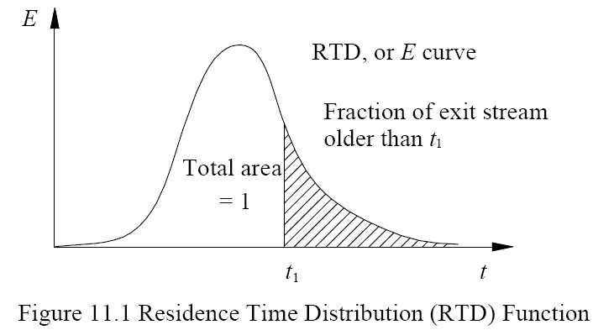
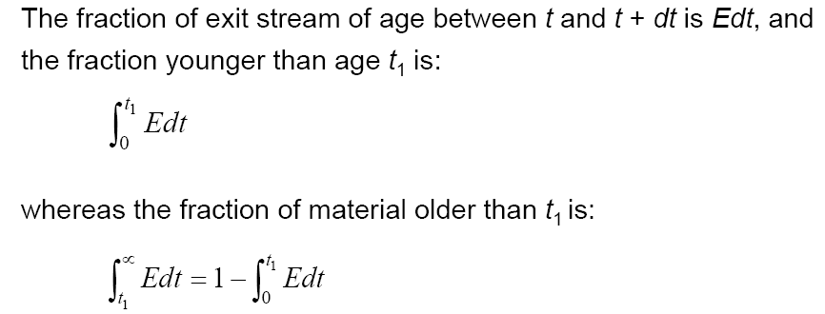
Residence time distribution (RTD) function (E function) is proposed to describe residence time presented by different reaction elements inside a reactor, therefore:
The direct reason responsible for RTD is mixing within a reactor, thus, RTD can be used to describe all kinds of non-ideal flow presented within real reactors mathematically.

Slide 4
Experimental Methods to determine RTD
In order to characterize the extent of non-ideal flow by means of RTD, we should like to know how to evaluate E for any flow.
For this we resort to the experimental method named stimulus response technique.
In this, stimulus is usually a tracer input into the feed, whereas the response is a time record of the tracer leaving the vessel.
Any material that can be detected and which does not disturb the flow pattern in the vessel can be used as tracer, and any type of input signal such as a random signal, a periodic signal, a step signal, or a pulse signal, etc. may be used.

Slide 5
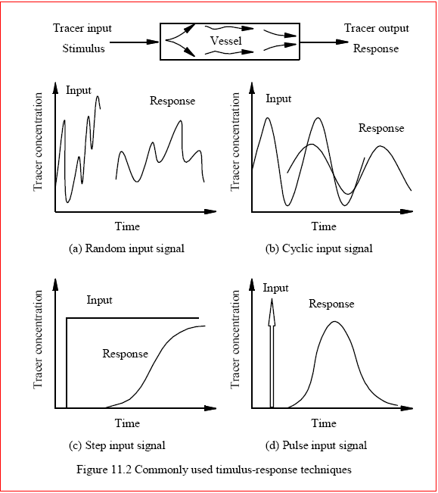

Slide 6
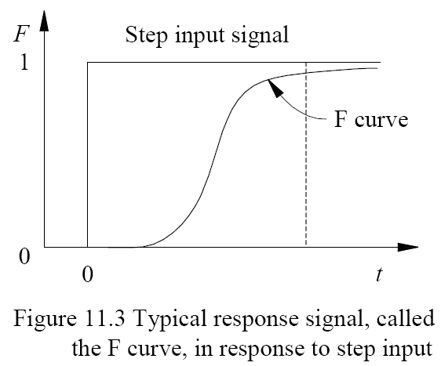
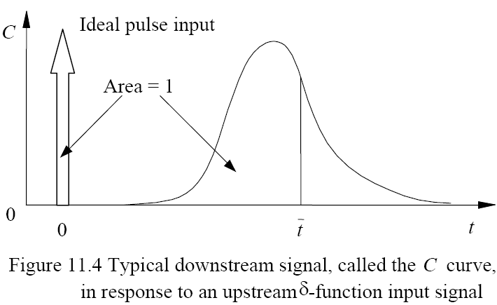
The F and C curve
The F Curve:
With no tracer initially present anywhere, impose a step input of tracer of concentration C0 on the fluid stream entering the vessel. Then a time record of tracer concentration in the exit stream from the vessel, measured as C/C0, is called the F curve.
The C Curve:
With no tracer initially present anywhere, impose an idealized instantaneous pulse of tracer on the feed stream. Such an input is often called a delta function or impulse. The normalized response is then called the C curve.

Slide 7
Models for Non-Ideal Flow reactors
Many types of models can be used to characterize non-ideal flow presented within real bioreactors.
One-Parameter Models such as the tanks-in-series model and the dispersion model are widely used in bioreaction engineering.
The dispersion model is mainly used to design medium continuous sterilization processes or some enzyme catalytic reactions carried out within tubular reactors.
There are also Two-Parameter Model of CSTR with Bypassing and Dead Space.

Slide 8
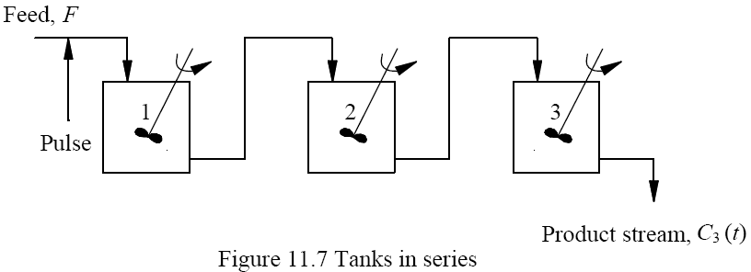
1. The Tanks-in-Series Model
The RTD will be analyzed from a tracer pulse injected into the first reactor and gives:

Slide 9
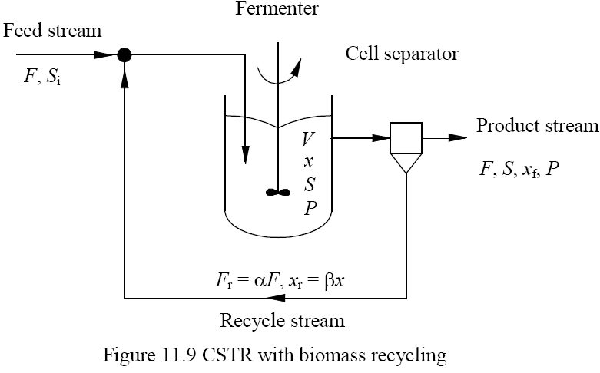
2. CSTR with Biomass Recycle
Cell concentration in a single CSTR can be increased by recycling biomass from the product stream back to the bioreactor.
By this way, much higher rate of substrate conversion and product formation can be achieved.
With cell recycling, the critical dilution rate for washout is also increased allowing greater operating flexibility.

Slide 10
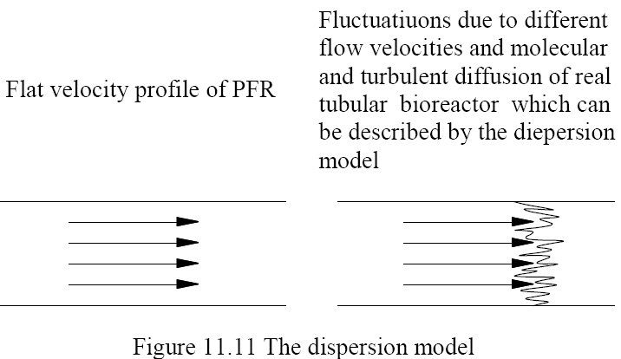
3. The Dispersion Model

Slide 11
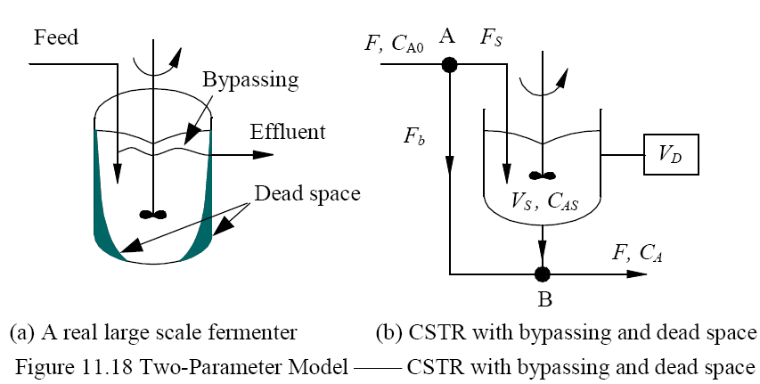
4. Two-Parameter Model, CSTR with Bypassing and Dead Space
Dead space where no reaction takes place and bypassing flow are inevitable within a large scale fermenter.
The model of CSTR with Bypassing and Dead Space can be used to describe this non-ideal flow existing inside a real bioreactor.
The total volume of reactor, V, is composed of an ideal CSTR, VS and a dead zone, VD and a bypass with a volumetric flow rate Fb, as illustrated below, here we define:

